Slide 1
Unmasking Deception: Fake News Detection Using Bidirectional LSTM
Najeebuddin, Mohammed

Slide 2


Background
Data that is false or misleading or whose source cannot be verified.
Why?
To intentionally damage reputations, deceive or to gain attention.
To increase number of clicks and visitors on a site.
To influence public opinion on political decisions or on financial markets.

Slide 3
Introduction
Why is this research important?
Detection of deception in textual data is crucial for various applications such as fake news detection, fraud detection, and sentiment analysis.
What we know and what we don't:
We know that Bidirectional LSTM (Long Short-Term Memory) networks are effective in capturing sequential patterns and dependencies in text data.
We don't know how well Bidirectional LSTM models perform compared to other NLP techniques in unmasking deception.
Our experiment:
We will conduct an experiment to compare the performance of Bidirectional LSTM networks with other NLP techniques such as TF-IDF and Bag-of-Words in detecting deception in textual data.
Our hypothesis:
We hypothesize that Bidirectional LSTM networks will outperform traditional NLP techniques in identifying deceptive patterns due to their ability to capture long-range dependencies in text data.

Slide 4
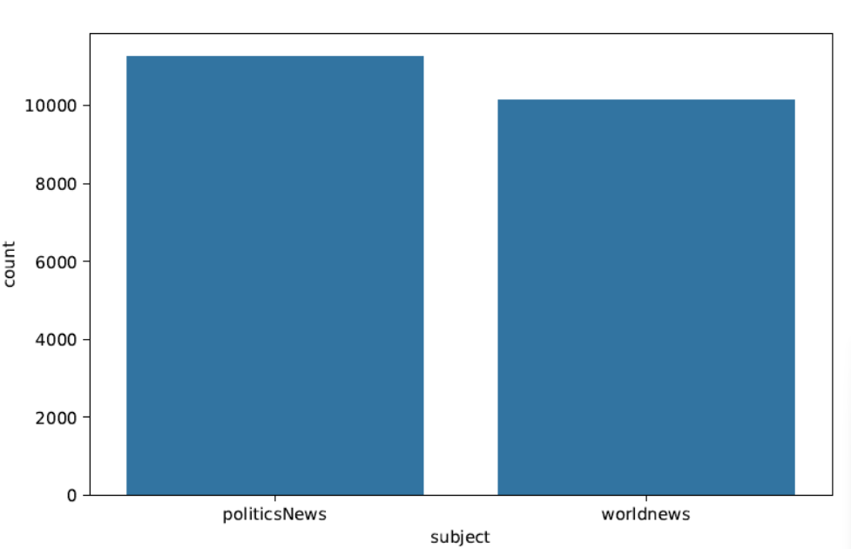
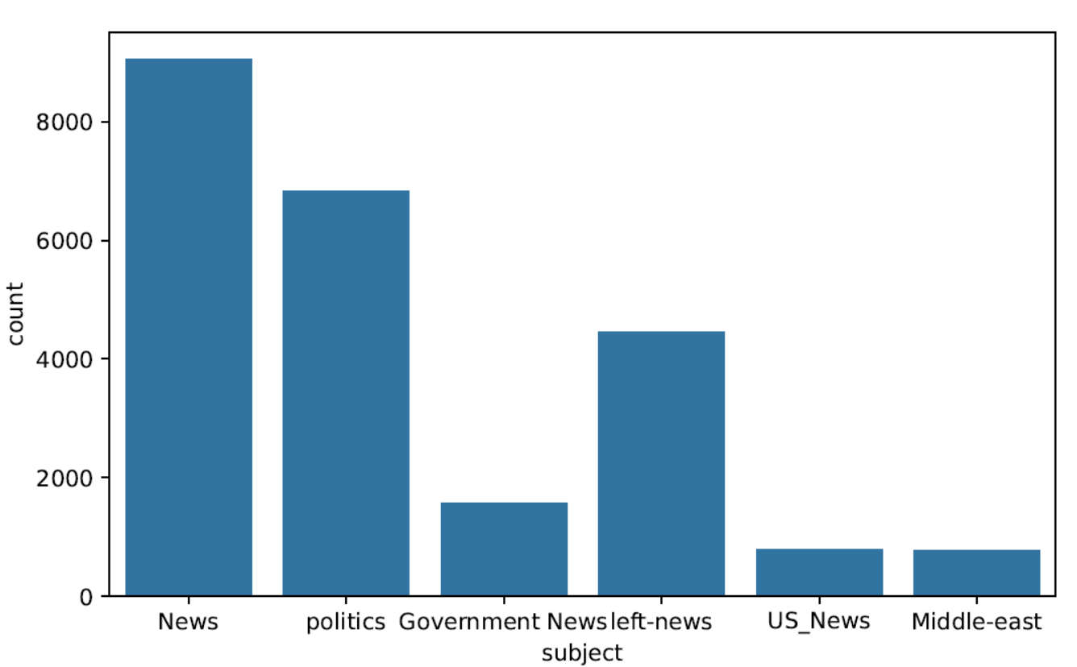
Data Set
The ISOT Fake News Dataset serves as the foundation for this research endeavor.
Comprises articles categorized into real and fake news.
Articles were sourced from reputable platforms like Reuters.com for truthful content.
Fake news articles were flagged from unreliable sources.
Temporal focus on articles primarily from 2016 to 2017, aligning with significant political discourse.
Each article includes essential information such as title, text, publication date, and categorization as real or fake news.
Dataset retains characteristics of fake news articles, such as punctuation and mistakes, reflecting real-world misinformation.
Fake News Categories
Real News Categories

Slide 5
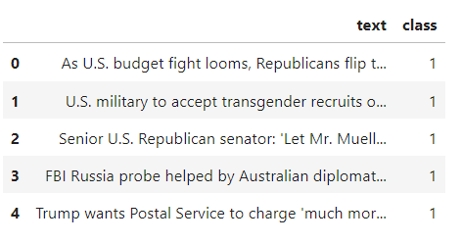

Pre-processing
Class labels are assigned to distinguish between real and fake news articles, with real articles labeled as class 1 and fake articles as class 0.
Title and text content of each article are combined into a single cohesive body to streamline the text processing pipeline.
This consolidation enhances the effectiveness of subsequent natural language processing (NLP) tasks by providing a unified textual representation for analysis.
Attributes that do not contribute significantly to the analysis are removed from the dataset.
Specifically, the subject field, which differs between real and fake articles, is dropped, along with the date, title, and publisher information for real articles.
This pruning of extraneous attributes streamlines the dataset and focuses attention on the essential text content and class labels.
Finally, the processed real and fake datasets are merged into a single dataframe, denoted as 'df,' enabling comprehensive analysis and modeling of the combined dataset.
Real News after cleaning
Fake News after cleaning

Slide 6
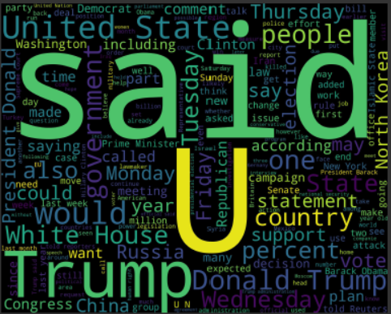
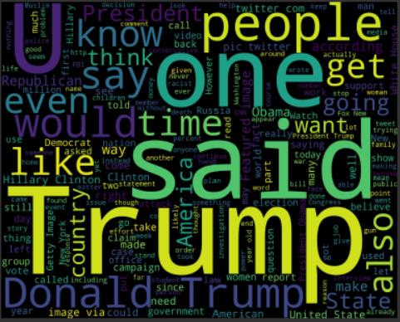
Word Cloud – Real News
Word Cloud – Fake News

Slide 7
Methodology
Text Preprocessing:
Tokenization: Break down text into individual tokens or words.
Cleaning: Remove punctuation, stopwords, and irrelevant characters.
Combining: Merge title and text content of each article into a unified body.
Removal: Eliminate attributes such as subject, date, title, and publisher information to focus on essential content.
Merging: Combine processed real and fake datasets into a single dataframe for comprehensive analysis.
Word Embeddings:
Word2Vec Embeddings: Generated using Gensim library to learn distributed representations of words.
Semantic Information: Encode rich semantic information to model word context, similarity, and association.
Numerical Representations: Convert tokenized text sequences into numerical representations for input into deep learning models.
Feature Engineering:
Transformation: Convert raw text into numerical sequences.
Padding/Truncation: Ensure uniform input dimensions by padding or truncating text sequences.
Continuous Vector Space: Embed numerical sequences into a continuous vector space to capture intricate patterns and relationships.

Slide 8
Model Selection:
Architecture: Embedding layer initialized with pre-trained Word2Vec embeddings, followed by LSTM and dense layers.
Semantic Relationships: Capture semantic information and contextual relationships within news articles.
LSTM Layer: Handle sequential nature of input data to capture temporal dependencies and long-term patterns.
Binary Classification: Utilize dense layer with sigmoid activation function for binary classification.
Evaluation Metric: Employ binary cross-entropy loss function and accuracy for model optimization and performance assessment.
Model Training and Evaluation:
Dataset Splitting: Split dataset into training and testing sets with a ratio of 75% for training and 25% for testing.
Training Process: Train model on training data for 7 epochs, adjusting parameters iteratively to minimize loss.
Validation: Monitor model's performance on a validation subset to prevent overfitting and ensure generalization.

Slide 9
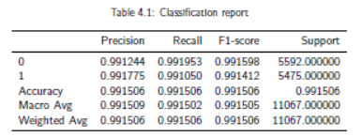
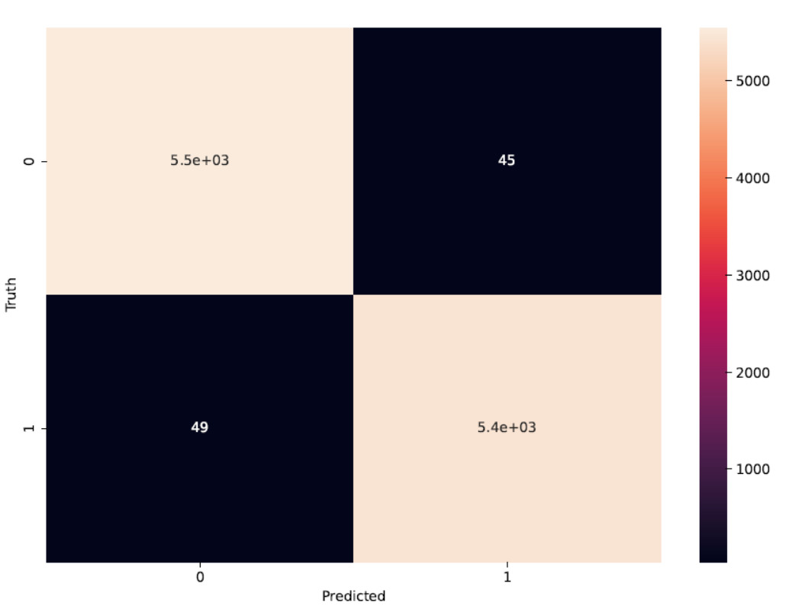
Result and Discussion
High accuracy of nearly 99% on the test dataset suggests effective distinction between fake and real news.
Consistently high precision, recall, and F1-score metrics for both fake and real news classes underscore the model's robustness in classification tasks.

